Slide 2

Data Modeling Considerations in GPDB
Notes:
Intro: my name is, my role is, …

Slide 3
Agenda
Introduction
Models & Background
Pivotal Approach
Possible Optimizations
Notes:
Greenplum Database is flexible, accommodating various modeling techniques.
Star schema are very IT driven solutions and aren't very agile. I've always had the best success with simply copying
the the OLTP tables as-is and then letting users denormalize them into 1NF tables.
Instead of following some out-dated dogma about which model is best suited to the EDW, just copy the OLTP tables
to Greenplum. Empower the users to query the data. They will naturally build flattened table structures with the data
they need. Later, optimize it with partitioning and compression; stay out of the way of the business.

Slide 4
Introduction
Greenplum database is not limited to specific models as some other database platforms are
Greenplum supports features that are used in modeling:
Uniqueness
Constraints
Keys
Greenplum does not support some features that are frequently used in modeling:
Foreign keys
Relational Integrity checks

Slide 5
Introduction (cont’d.)
Just because Greenplum supports items like primary keys and constraints does not mean they should be used pervasively
Also, just because your organization spent years modeling the existing warehouse does not mean it is functional for the users of the system
Bill Inmon and Ralph Kimball practiced and developed their ‘schemes’ in a world before MPP. Their models and approaches reflect the technical time in which they were developed

Slide 6

Key Modeling Considerations
The following are key modeling considerations:
Consider the business first
Model for usability NOT to fit a model
Do not force data into a model which does not fit the use
Leave relational integrity checking to the source system
Iterative and agile modeling is recommended over archaic and inflexible/prescriptive methods
Legacy models will likely not be optimal*
* Just because you have worked for years on your optimal DW model
does not mean it will work for the business or perform well

Slide 7


Historical Approaches
As mentioned previously, the models from Inmon and Kimball have been subscribed to as “the way to architect a data warehouse”. These models:
Star Schema
Snowflake Schema
have been used to supplant the classic database pattern:
3NF or Third Normal Form which is frequently used in OLTP applications
Each model will be detailed at a high-level in the coming slides
Note: Each of the models listed is rigid in it’s rules for data relationships and typically takes years to develop
A fly and a flea in a flue
Were imprisoned, so what could they do
Said the fly, let us flee. Let us fly said the flee
So they flew through a flaw in the flue.
A canner exceedingly canny
One morning remarked to his granny
A canner can can anything that he can
But a canner can’t can a can can he?

Slide 8
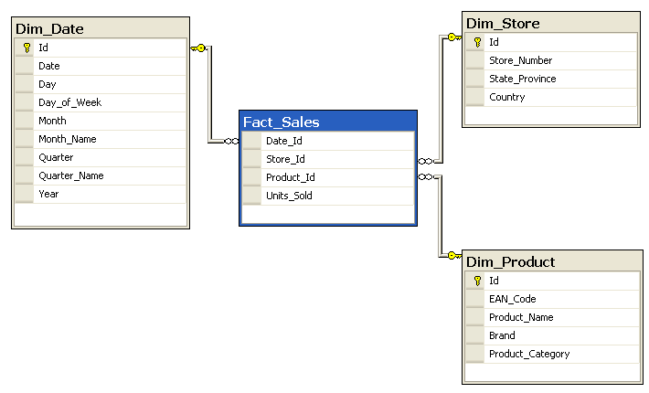
Star Schema Model
Notes:
The dimension table:
Also known as a lookup table, has a known entry point to a fact.
Provides a description of the fact. For example, the Dim_Store dimension table contains descriptions of the store, including the store number, ID, and location.
Has a single primary key for each record. This primary key uniquely identifies the store in the Dim_Store table.
The fact table:
Combines the information provided in the lookup tables to provide a measurable account of a unique record.
The fact table in this example, Fact_Sales, identifies the date, store ID, product ID, and number of units sold for each unique record.
A unique record can be determined by a combination of primary keys, or a compound primary key.
It may not be enough to uniquely identify a transaction or sale just by the Date_Id. It may require that all four fields in the table uniquely identify a sale.

Slide 9
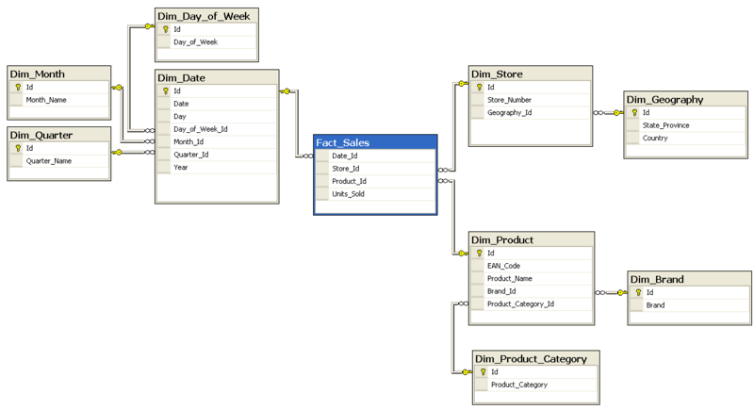
Snowflake Schema Model
Notes:
In the snowflake schema, the dimensional tables are further normalized into multiple lookup tables.
Your data is no longer represented in a single dimension, but is now shown as a dimensional hierarchy.
Snowflake schemas offer some improvement in query performance due to minimized disk storage requirements and joining on smaller tables; however, this comes at a price.
Additional maintenance is required due to the increased number of lookup tables generated by this type of model.

Slide 10
3NF Model
Relationship is established
Tables are categorized
Notes:
The third normal form (3NF) design normalizes data to remove redundancy and groups data together by subject areas or categories.
This can be difficult for users to understand, but it is well suited to capturing the complexities of real world entities and the resulting data.
This type of model can be used to help identify patterns and trends instead of simply providing reporting support and support for well established relationships.
The example on the slide shows the following relationships:
A country can have multiple zip codes.
A state can have multiple zip codes.
In a zip code, you can contain multiple customers.
Ref. https://en.wikipedia.org/wiki/Third_normal_form

Slide 11
A Pivotal Approach
Consider the following when modeling for Greenplum:
Primary keys are essential for OLTP and as such their “primary-ness” should be established prior to loading
Business users look at the data based on how they use it – Model to reflect this “use” pattern
Don’t blindly follow a pattern espoused by experts unless it fits the usage of the data
Data reorganization within a greenplum system is exceedingly fast, so iterate over models until one resonates with the users
Storage on MPP is not usually as constrained as on other systems so it may be appropriate and useful to have multiple copies of a data set to support different uses
Notes:
Primary keys = unique indexes and are usually more of a hindrance than they are worth
[Add talk track here, based on bullets]

Slide 12
A Pivotal Approach (cont’d.)
Other considerations when modeling for Greenplum:
Avoid over-modeling which can result in large numbers of joins that tend to not be as performant
Flattening is okay and encouraged in Greenplum and it has the side effect of making more sense to business users…
Model, test, iterate – be agile and figure out what works best for the determined use
It is possible and can be very functional to leave data outside the database, accessing it as needed via the powerful external table mechanism in Greenplum*
* Data can be filesystem based or can live in hadoop
Notes:
Primary keys = unique indexes and are usually more of a hindrance than they are worth
Large #’s of relations = large #’s of joins – avoid this

Slide 13
Pivotal Approach Example
Notes:
Let’s call this the “Pivotal Approach”.
Notice here how we’ve flattened the data into fewer, larger, tables, resulting in some redundant data.
The resulting model is likely to make more sense to the consumers of our data warehouse, and queries against this model are likely to perform well, as long as we apply the practices detailed elswhere within this course.
For example, with the tables shown here, GPDB joins between these two large fact tables will perform well, so long as:
The customer table is distributed on the customer.customer_id which is defined as type INT.
The Sales table is also distributed on the sales.customer_id, also defined as type INT.

Slide 14
Pivotal Approach Example Explained
As suggested it can be very effective to create a flattened view of data:
More closely fits with a business view of the data
Easier to query
Faster to query
Can still join to information not flattened into the fact
e.g. Customer demographics Customer geo information
Minimizes in-memory data structures
Notes:
Primary keys = unique indexes and are usually more of a hindrance than they are worth
Large #’s of relations = large #’s of joins – avoid this

Slide 15
Pivotal Approach Possible Optimizations
Don’t over-think it
Use the power of the system to evaluate and test different approaches
Don’t force data sets into a certain model
Relax -- it is just data and can be reorganized into most any “shape” that is desired
Utilize the right tool for the right job e.g. don’t use GPDB to enforce RI; don’t use your OLTP database for analytics
Don’t forget the powerful capabilities of GPDB to ingest and utilize data that may be outside of the database
Greenplum includes many features to improve performance: compression, columnar, partitions, etc.
Notes:
Primary keys = unique indexes and are usually more of a hindrance than they are worth
Large #’s of relations = large #’s of joins – avoid this
Yes, the last bullet is all physical model related, but it bears repeating while dealing with the logical model

Slide 16
Review
Models & Background
Pivotal Approach
Possible Optimizations
Notes:
(1) It is up to the customer to decide the data model and
(2) We shouldn't be dogmatic when it comes to data modeling.
[FIXME]
Grenplum Database gives you the power and flexibility to be agile in your data modeling.
By applying the principles introduced within this course, including table storage models, table partitioning, external tables, physical design, and aothers,
We think that you will well equipped to successfully model data within GPDB.
Thanks to Randy Willard, Jon Roberts, and Derek Comingore for their valuable assistance with preparation of this material.
Thank you for watching.

